Slide 1

WOREP: What we learned at CSUF?
Will Breitbach
California State University, Fullerton

Slide 2

Why WOREP?
Reference assessment
Paired survey
Standardized
Low cost
Notes:
Having knowledge about the quality of your reference service may give you ideas about areas of potential improvement
Designed specifically for in-person reference service – unlike some other popular tools like LibQUAL
A reference assessment that attempts to gather information about both service and success – attempts to go beyond a simple “satisfaction” rating.
A paired survey that obtains success and satisfaction information as well as descriptive data from the patron and a great deal of descriptive data from the librarian – including detailed description of the question – this is one aspect of the survey that was really appealing to us. We thought the paired survey would allow us to see if librarian and patron viewed the reference transaction in the same way. In essence, did we understand our users?
Expert designed standardized questionnaire, that is processed by WOREP administrators and provides data by which you can compare your institution to others. 136 Academic libraries have used the instrument with a total of 13448 transactions assessed.
Low cost – $1.25 per survey

Slide 3
Preparation
Sampling Strategy
Survey procedure
Training - website
Notes:
Different sampling strategy – every patron v. first 2 patrons per sampling hour – most importantly you want a representative sample and you want to avoid sampling bias.
that is you want the sample to represent the real world (represent busy and slow times).
Ask for participation upon the conclusion of transaction. You want to ask at the end of the survey because you don’t want the survey to impact the quality of service or the survey responses.
Training is required – everyone on the ref team went through the training session
Most of the training effort focused on the subject coding.
We selected a small group of librarians to do an initial “norming” of the coding procedure.

Slide 4
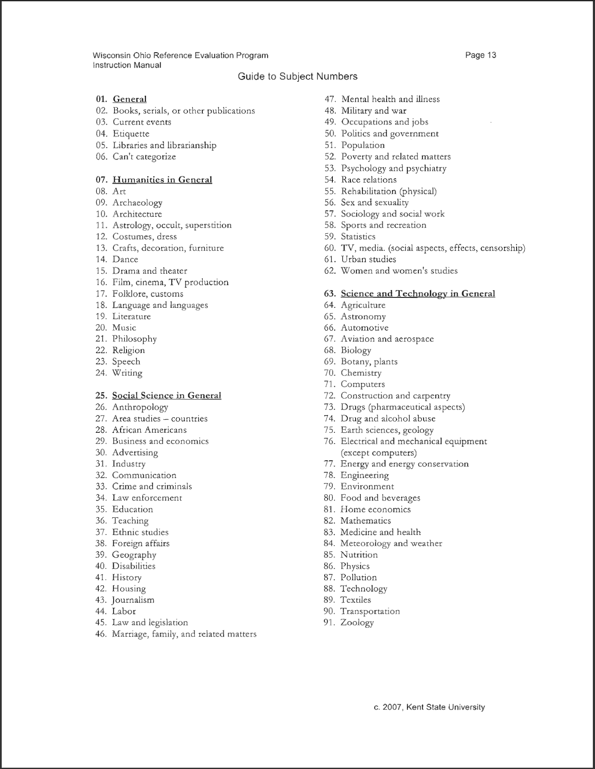

Slide 5
We learned…
We are not horrible!
Notes:
Actually, we learned that we did well in comparison to top scoring institutions. That in and of itself is good to know. We had hoped to get detailed subject level information so we could identify subject areas where training was needed etc. That did not happen.

Slide 7
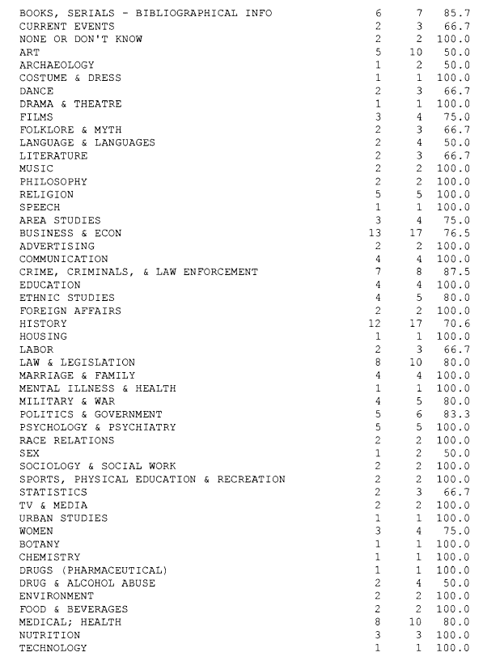
Notes:
The first number here represents the number of successful transactions per subject and the second number is the total number of questions per subject. The third is the percentage.
The sample size for individual subjects is too small in most cases to give us data we can use to develop training. That was a bit of a disappointment. We thought the subject level data would be among the most valuable information in the survey. The studies I read don’t focus on this data, likely because the got the same results.

Slide 8
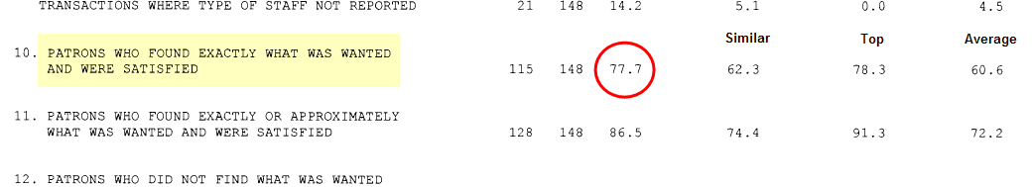
Success & Satisfaction

Slide 9
Success & Satisfaction

Slide 10
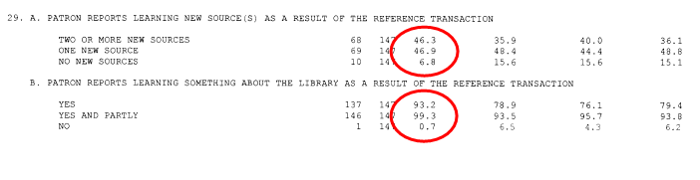
Learning

Slide 11
Learning sources

Slide 12
Learned about library

Slide 13
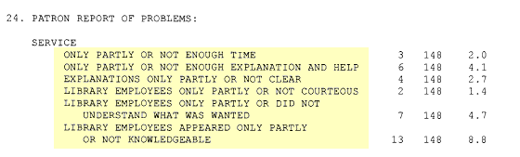
Potential concerns

Slide 14
Satisfaction v. Time

Slide 15
Satisfaction v. # of Sources

Slide 16
Lessons learned
Sample size
Sample method
Subject coding

