Slide 1
"How Do I Assess That?“
Digital Reference
Cynthia Johnson, UC Irvine Libraries
California Academic Reference Librarians Discussion Interest Group-South
December 3, 2010

Slide 2

UC’s launch Ask a UC Librarian collaborative chat reference
Launched in November 2006 and declared a success six months later.
How did we assess that?

Slide 3
Numbers:
We answered approximately 2,360 questions from students at eight of the ten UC campuses

Slide 4
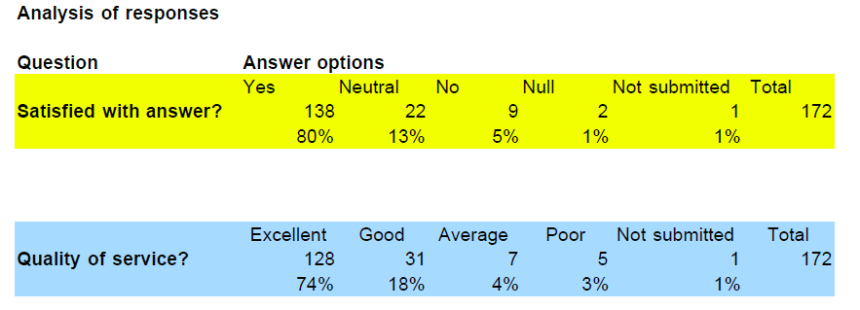
Patron satisfaction:

Slide 5
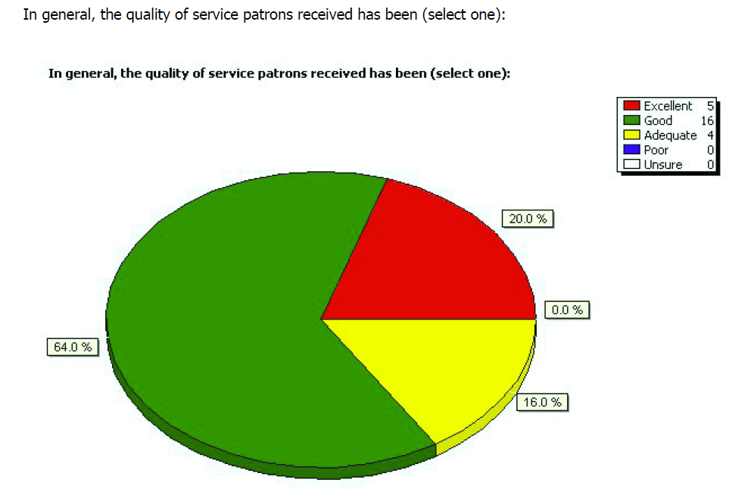
Librarian perceptions:

Slide 6
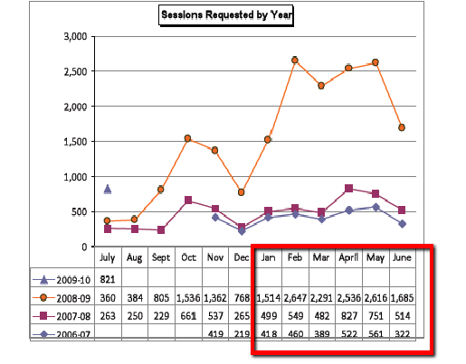
Volume of Questions from UC Patrons, 2006-2009
Qwidget introduced October 2008
24/7 hours began January 2009

Slide 7
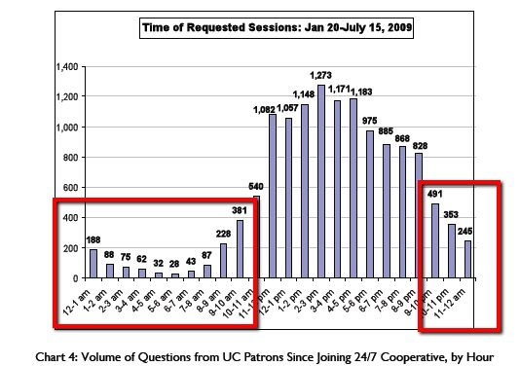

Slide 8
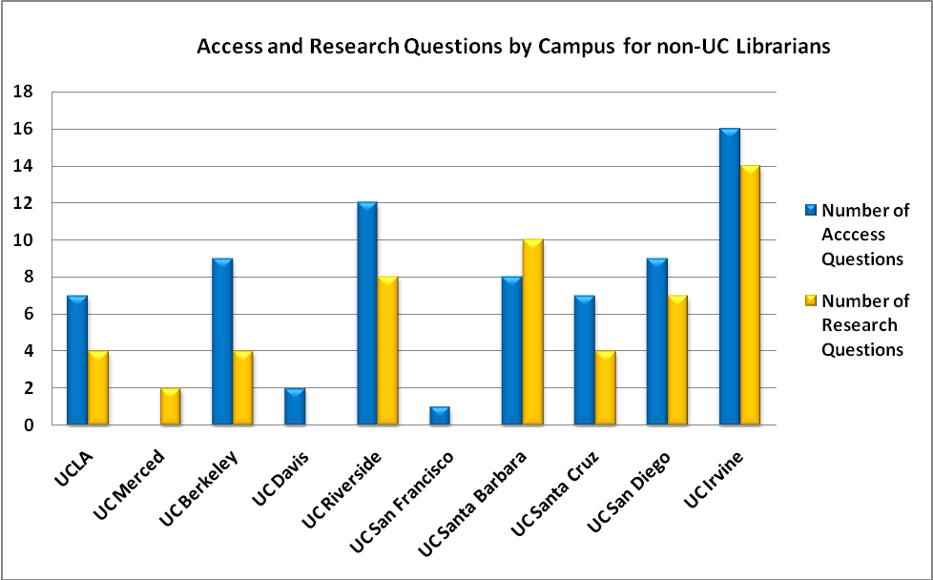

Slide 9
Rubric for Ask a Librarian Chat Transcripts
Greeting | 4. A personal greeting is sent and indicates willingness to help.
 | 3. A personal greeting is sent, but does not indicate willingness to help.
 | 2. A personal greeting is sent, but is inadequate, abrupt, or incomplete.
 | 1. No personal greeting is sent.
 | N/A
Reference Interview | 4. If necessary, patron’s question is clarified at appropriate points during the transaction. Reference interview is adequate to understand the question and the patron’s information need.
 | 3. Reference interview is adequate, but does not clarify patron’s question at appropriate points during the transaction.
 | 2. Reference interview does not clarify patron’s question and fails to identify patron’s information need.
 | 1. No reference interview.
 | N/A

Slide 10
Rubric for Ask a Librarian Chat Transcripts
Quality of Sources | 4. One or more relevant sources are used. Sources are at the appropriate level for the patron’s research. [In general, databases are preferable to Google or other general sources when assisting students with research projects.]
 | 3. Only one relevant source is used when more are appropriate.
 | 2. All sources are dubious.
 | 1. No relevant sources are used.
 | N/A
Factual Information (e.g. phone numbers, policies, URLs) | 4. Provided information and source.
 | 3. Provided information without the source.
 | 2. Did not provide answer but made appropriate referral or marked as follow-up.
 | 1. Did not provide answer or referral and did not mark follow-up.
 | N/A

Slide 11
Rubric for Ask a Librarian Chat Transcripts
Instruction | 4. Transaction includes detailed instruction with examples and/or how-to steps. Librarian may instruct how to: create search terms and strategies, select databases, search databases, cite sources, and/or evaluate sources.
 | 3. Transaction includes some instruction. Librarian may provide database suggestions with links, search term suggestions, and citation guides with links. Detailed assistance, such as use of examples, is not provided.
 | 2. Transaction includes limited instruction. Librarian may suggest databases, but links and/or search term assistance are not provided.
 | 1. Transaction warranted instruction, but none provided.
 | N/A
Interpersonal Skills | 4. Interpersonal skills create a welcoming atmosphere. Librarian chats frequently without long lags and shows interest in the patron’s question. Librarian uses positive phrasing; also uses scripts appropriately, as needed.
 | 3. Interpersonal skills create a mostly welcoming atmosphere; although there may be some lags, and/or not enough positive phrasing. Scripts are used appropriately, as needed.
 | 2. Interpersonal skills create a less than welcoming atmosphere. There are long lags and the Librarian does not show adequate interest in the patron’s question. Does not use much positive phrasing. Does not use scripts appropriately.
 | 1. Interpersonal skills are completely lacking and inadequate.
 | N/A

Slide 12
Rubric for Ask a Librarian Chat Transcripts
Concluding the Session | 4. The conclusion is complete: the Librarian asks the patron if their question has been completely answered. If not, the session is coded for follow up. Before coding, the patron’s e-mail address and deadline are verified. If no more information is needed, patron is thanked for using the service and encouraged to return.
 | 3. The conclusion is mostly complete, but missing one of the follow up components.
 | 2. The conclusion is not complete and is missing more than one of the follow up components.
 | 1. Conclusion is inadequate, abrupt, or missing completely.
 | N/A - Mark if the patron disconnects without allowing the librarian to conclude the session.
Average Rating Key
4 | Superior Service
3 | Adequate Service
2 | Room for Improvement
1 | Inadequate Service
0 | Not enough information was provided to accurately rate the transcript's quality of service.
Average ratings were derived by averaging the ratings for each section when there was sufficient information present in the transcript to make an evaluation. If there was insufficient information, the category rating was left blank and not taken into account when creating the average score.

Slide 13
Question Type: Research |  |  | Patron: I'm writing an advocacy essay on torture and extraordinary rendition. I have chosen the bill that I will most likely focus on but I am having difficulty find sources and support or go against the bill itself. My bills are the Terrorist Detainees Procedures Act of 2009 and Interrogation and Detention Reform Act of 2008. please email me Librarian: We have a research guide done at our library on torture that includes lots of sources and documents - I will send it to you. The guide covers that spectrum of Terrorism - check the sources under Legal Issues: http://non-uc-library.edu/guides/XXX/general/terrorism.html oh - I will email it to you. I just emailed it too you. Patron is no longer connected. Librarian ended chat session. Note: Set Resolution: Answered
Greeting | 1
Reference Interview | 1
Quality Sources | 3
Factual Information | 4
Instruction
Interpersonal Skills | 3
Concluding the Session | 1
Average Rating: | 2.16

Slide 14
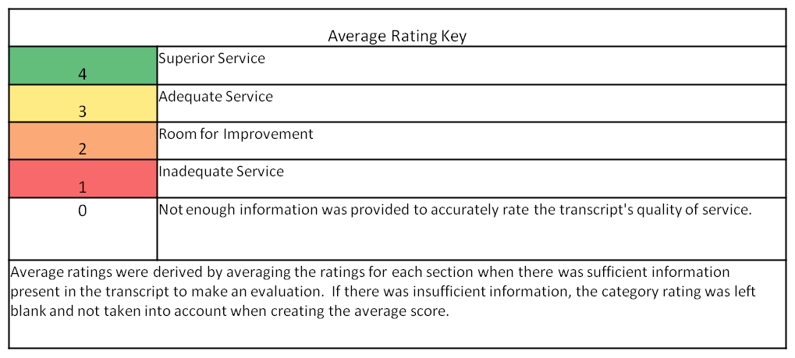
You rate it!
Greeting
Reference Interview

Slide 15
Patron: How do I find experts on a topic? Librarian Hi. I'm XX a librarian at XXX College in New York. Your library and my library are part of a nation-wide cooperative that staffs this service. Please be assured I will do my best to help you. I'm reading your question now.

Slide 16
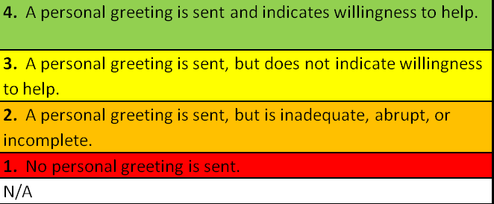
Rate the Greeting

Slide 17
Patron: My discussion professor asked us to list three experts on our research topic and I'm researching Dr. Seuss and his influence on the modern media and literary world. How would I find experts on that?
Librarian: There are a few ways to find experts…When you are doing research and you see the same author writing on the same topic… Some view if the author has 3 or more written scholarly pieces on the article they are considered expert…Others may view that the author has to be in the specific field of study and writing on the topic for some years. What have you searched so far?

Slide 18
Patron: What do you mean by that? Do you mean what kind of sources have I found?
Librarian: yes, Have you searched any databases or the internet or the library online catalog.
Patron: I've searched jstor.org for articles and yes the internet and the library database
Librarian: Often from the library online catalog you can get a sense of authors who are writing on a specific topic of study but I can't seem to find authors who have written about the topic more than once…Your topic is on literature? can you give me the keyword or key phases you have used?
Patron: I've only used "Dr. Seuss" to get the broadest information because searching for …My topic is basically how Dr. Seuss has influenced art, literature, political ideas, etc.

Slide 19
Librarian: Did you try "Dr. Seuss and "modern media" or literature…let me try the search in the library's online catalog. View the search from the library catalog…
Patron: Right, I have these sources on my bibliography already--but this doesn't consider these authors experts...
Librarian: This link is a list of literature databases you will have access to.
Patron: Okay, thanks so much, I think I have it from here
Patron ended chat session.
Librarian: If you need any further help, feel free to log back in...

Slide 20
Rate the Reference Interview
4. If necessary, patron’s question is clarified at appropriate points during the transaction. Reference interview is adequate to understand the question and the patron’s information need.
3. Reference interview is adequate, but does not clarify patron’s question at appropriate points during the transaction.
2. Reference interview does not clarify patron’s question and fails to identify patron’s information need.
1. No reference interview.
N/A

Slide 21
Overall ratings of our assessment
Average Overall Ratings |  | Average Access Ratings |  | Average Research Ratings
Greeting | 3.63 | Greeting | 3.62 | Greeting | 3.74
Reference Interview | 2.92 | Reference Interview | 4.00 | Reference Interview | 2.92
Quality Sources | 3.65 | Quality Sources | 3.57 | Quality Sources | 3.68
Factual Information | 3.61 | Factual Information | 3.52 | Factual Information | 3.58
Instruction | 2.87 | Instruction | 2.10 | Instruction | 2.85
Interpersonal Skills | 3.72 | Interpersonal Skills | 3.86 | Interpersonal Skills | 3.53
Conclusion | 3.40 | Conclusion | 3.54 | Conclusion | 3.33
Average for all questions | 3.49 | Average for access questions | 3.57 | Average for research questions | 3.38

Slide 22
Find an article
Books
Login to licensed resources
Community user services
How to start research on a specific topic
Interlibrary Loan
39 C How to find a bill on their specific topic
Equipment usage
Access JSTOR database
Location of books- Call number floor/map
Top 10
Digital Reference
Transcript
Questions

Slide 23
Notes:
CP Speaker Notes: One reason we think we get so many questions about starting research through our Digital Reference service is because the Databases to Get You Started page prominently displays the Ask a UC Librarian chat widget.
Libraries homepage so that I can point out the Databases to get you started link

Slide 24
Notes:
CP Speaker Notes: Point out the Ask a Librarian widget

Slide 25
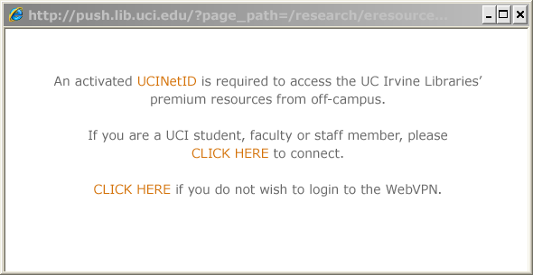
Notes:
CP: Another implemented intervention is the VPN pop-up. Explain how this works. Give statistics.

Slide 26
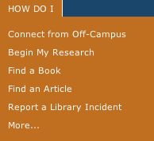

Slide 27
Questions?
Cynthia A. Johnson
cynthiaj@uci.edu

